Slide 1


ZEAL EDUCATION SOCIETY’S
ZEAL COLLEGE OF ENGINEERING AND RESEARCH NARHE │PUNE -41 │ INDIA
COMPUTER ENGINEERING DEPARTMENT
Academic Year: 2023-2024 Semester: 2
A Seminar Presentation On
“ TRAVEL MATE ”
Project Presented By : Group 36
1) Arhaan Shaikh | S213027
2) Imam Shaikh | S213028
3) Sakshi Shelar | S213029
4) Sairaj Shilimkar | S213032
5) Om Shinde | S213033
Guided By:
Prof. Komal M. Bhosale Mam
Department of Computer Engineering
1

Slide 2
CONTENTS
Abstract
Introduction
Objective
Problem Statement
Hardware and Software requirements
Literature Review
Motivation
Architecture/Model
Methodology
Conclusion
References
Department of Computer Engineering
2

Slide 3
ABSTRACT
Travelmate is a revolutionary website aimed at transforming the way people plan and experience their travel adventures. Travelmate is dedicated to providing unparalleled service and creating unforgettable travel experiences.
At Travelmate, our primary goal is to deliver quality service, ensuring the safety, satisfaction, and enjoyment of our users. Our unique service connects travelers with compatible travel partners, enabling them to explore the world together as buddies.
Our innovative website serves as a platform where individuals can find travel partners for their upcoming trips. Users can post details and plans about their trips, while others interested in joining can easily connect with them. Through open communication and collaboration, users can discuss trip details and make informed decisions together.
With Travelmate, planning your next adventure has never been easier. Join our community today and embark on memorable journeys with like-minded travel companions.
Discover new destinations, forge lasting friendships, and create cherished memories with Travelmate by your side.
Department of Computer Engineering

Slide 4
INTRODUCTION
The "Travel Mate" finder website is a platform that connects individuals seeking travel companions for specific destinations. These websites allow users to find like-minded travel partners, plan trips together, and share travel experiences. Some features of these platforms include creating a profile, searching for activities based on location and categories, and joining or creating trips to find compatible travel buddies.
At Travel Mate, we're all about connecting passionate travelers with like-minded adventurers. Whether you're a solo explorer or a group enthusiast, we've got the perfect travel buddy waiting for you.
Our platform makes it easy to find, interact, and plan trips with fellow globetrotters. Say goodbye to boring solo trips and hello to unforgettable journeys with new friends!
Department of Computer Engineering
3

Slide 5
OBJECTIVE
Our travel mate finder website aims to achieve several key objectives based on the information gathered from various sources:
The primary goal is to connect individuals with like-minded travelers heading to similar destinations.
One of the main objectives is to address the crucial aspect of trust in decision-making when selecting travel mates.
By providing a user-friendly interface and features like detailed profiles, the website aims to enhance user experience and help users make informed decisions about their travel companions.
Another broader objective highlighted is to develop and promote various tourist destinations, contributing to the growth of the tourism industry.
Department of Computer Engineering

Slide 6
PROBLEM STATEMENT
The problem statement of a travel buddy finder project lies in the complexities and uncertainties travelers face when seeking suitable companions for their journeys. Trust and safety emerge as critical concerns, as individuals must navigate the challenge of establishing trust with potential travel buddies whom they may have never met before.
Compatibility and preferences further complicate the search, as travelers often struggle to find companions who align with their budget, destination choices, and preferred travel styles. User segmentation adds another layer of complexity, requiring a deep understanding of diverse user groups such as students, working professionals, and married individuals to tailor the platform effectively.
Department of Computer Engineering
5

Slide 7
SOPROBLEM STATEMENT
HARDWARE AND SOFTWARE REQUIREMENTS
Operating System: Windows 11
Programming languages: HTML, CSS, JavaScript
Framework: React js
Server: node js web server
Database Management System: MongoDB
Software: VS Code, firebase, GitHub
System: Windows 11
Department of Computer Engineering
5

Slide 8
LITERATURE REVIEW
Sr. | Research Paper Name | Author | Finding
1) | Website Design and Development Using Advance TechnologReact- JS[2023] | Rahul chauhan Harish Prasad Semwal Bannilo Fernandes Vinod N. Alone | This article provides an in-depth look at the key features of web applications that enable user interaction, such as flexibility, flexible content, and scalable graphics, effects, and content that can be accessed across multiple platforms.
2) | Hybride Database System of MongoDB in Web Application Development[2020] | Gregorius Ongo Gede Putra Kusuma | The design system can manage names,
3) | Web Design Playground: HTML & CSS The Interactive Way[2019] | Paul McFedries | This helps us to design the web page of the website
chat and profiles.
Department of Computer Engineering
6

Slide 9

MOTIVATION
The tour and travel market is vast and ever-growing, presenting immense opportunities for innovative solutions.
Many travelers face challenges when planning trips alone, such as loneliness, safety concerns, and limited experiences. Travelmate addresses this need by connecting individuals with like-minded travel partners, enabling them to explore together as buddies. Our innovative website serves as a platform where users can easily find travel partners for their upcoming trips. Through open communication and collaboration, users can discuss trip details and make informed decisions together.
Department of Computer Engineering

Slide 10
ARCHITECTURE/ MODEL
ARCHITECTURE / MODEL
Sign in
Sign Up
Home Page
Name:
Aadhaar:
Email:
Password:
Username:
Password:
Sign in/ Sign Up
Profiles Page
Individual Profile
Posts
Make a trip Book a Trip Find your Mate
Username
Bio
Profile 1
Like
Comment
Profile 2
Department of Computer Engineering
8

Slide 11
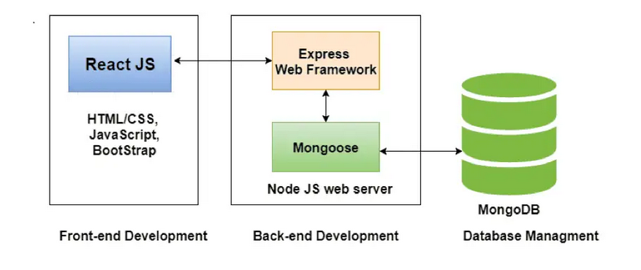
Methodology
n
Department of Computer Engineering
9

Slide 12

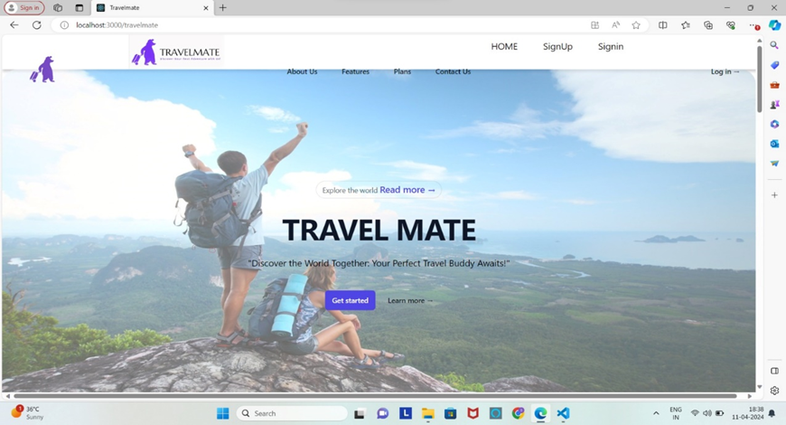
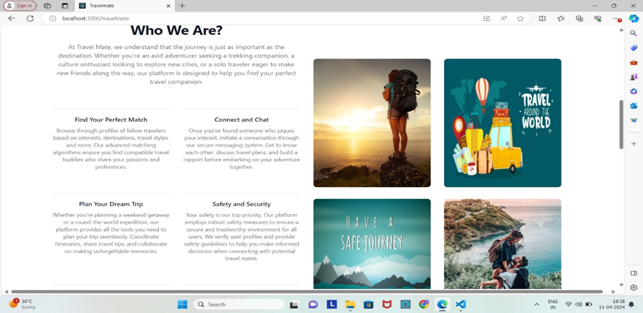
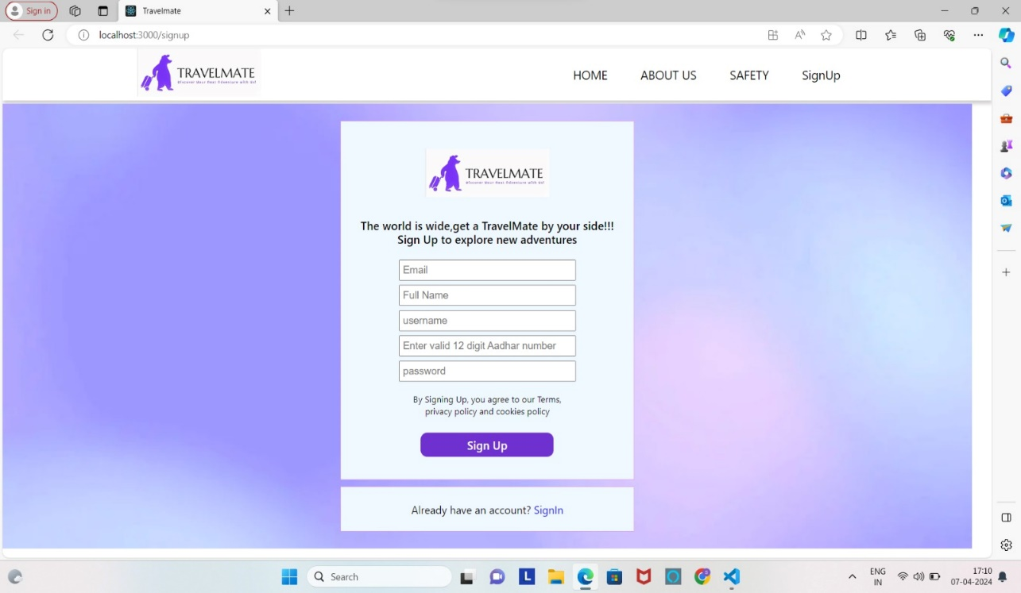
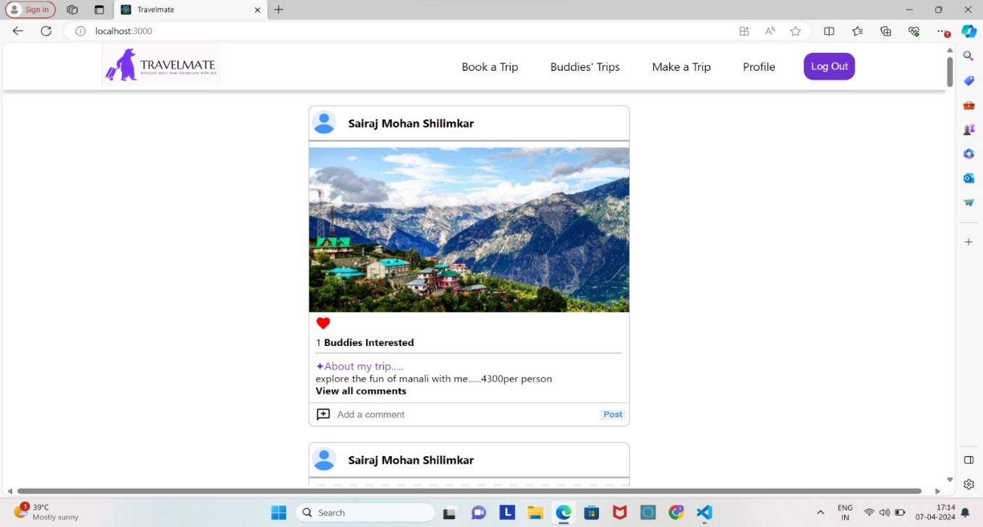
IMPLEMENTATION
Department of Computer Engineering
10

Slide 13
Applications
Our website has various many applications like follows:
It Facilitates Trip Planning by connecting users with like-minded travel companions for specific destinations.
It has Enhanced User Interactions and personalized recommendations, allowing travellers to plan trips, compare hotels, reserve rooms, and receive relevant assistance during their journey.
The website features a Community Section for travellers with similar interests to interact through posts, or comments.
It enhances the user experience by providing curetted suggestions and personalized recommendations, making the travel experience more memorable.
Department of Computer Engineering
11

Slide 14
CONCLUSION
In conclusion, a travel buddy finder website presents a valuable solution for travelers seeking companions for their journeys. By addressing the challenges of trust-building, compatibility, and safety, such a platform can offer convenience, cost-effectiveness, and social interaction opportunities to users. However, it is essential to consider privacy concerns, potential misunderstandings, and the reliance on technology as potential drawbacks.
Overall, with a well-designed architecture focusing on user experience, safety features, and service integration, a travel buddy finder website has the potential to enhance the travel experience for users and promote meaningful connections among like-minded travelers.
Department of Computer Engineering
12

Slide 15
Reference
https://www.researchgate.net/publication/285682764_Social_networks_and_travel_Some_hypotheses
https://www.researchgate.net/publication/45158767_Trust_perceptions_of_online_travel_information_by_different_content_creators_Some_social_and_legal_implications
https://www.academia.edu/14459851/Safety_and_security
https://ieeexplore.ieee.org/document/10467991/
https://ieeexplore.ieee.org/document/10439090/
Department of Computer Engineering
13

Slide 16
THANK
YOU
Department of Computer Engineering
14

